Slide 1
Interleaving Questions
Task: Individually answer the following questions in full sentences in your exercise books
What is the unit of force called? (1)
Is gravity a contact or non contact force? (1)
What store of energy does friction always produce? (1)
What three things can forces do? (3)
Mass and weight are the same, true or false? Explain why if incorrect. (2)
What two forces are sometimes referred to as ’drag’? (2)
With regards to effects of forces, what two factors might affect the air resistance? (2)
What is meant by a contact force? (1)
What is meant by a non contact force? (1)

Slide 2
Interleaving Questions
What is the unit of force called? (1)
Is gravity a contact or non contact force? (1)
What store of energy does friction always produce? (1)
What three things can forces do? (3)
Mass and weight are the same, true or false? Explain why if incorrect. (2)
The unit for force is Newtons (N)
(1)
Gravity is an example of a non contact force
(1)
Gravity is an example of a non contact force
(1)
(1)
(1)
(1)
Forces are able to change the speed, direction and shape of an object
(1)
False, Mass is the amount of matter in an object, Weight is a force due to the pull of gravity on an object measured in Newtons
(1)

Slide 3
Interleaving Questions
What two forces are sometimes referred to as ’drag’? (2)
With regards to effects of forces, what two factors might affect the air resistance? (2)
What is meant by a contact force? (1)
What is meant by a non contact force? (1)
(1)
Air Resistance and Water Resistance
(1)
(1)
(1)
Weight and surface area are the two factors that affect air resistance
‘What provides the force needs to touch the object for the force to affect it’
(1)
‘These are forces that don’t need to be in contact with what they are affecting’
(1)

Slide 4
Free Body Diagrams
Learning objectives:
LO1: State how different forces can be represented and correlate the length of arrows to the size of force (Level 3)
LO2: Describe that forces require both a size and direction, and understand why this is a vector quantity (Level 4)
LO3: Explain and be able to calculate resultant forces (Level 5)

Slide 5
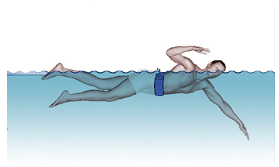

Recap: Forces
Task 1: Write down what the arrows represent?
Task 2:
Define what is meant by a force?
State 3 examples of contact forces
State 3 examples of non contact forces
Keywords:
Free Body Diagram
Resultant Force
Vector
Contact Force
Non Contact Force
Mass
Weight
Force
Newtons
Reaction Force
Arrows on a free body diagram show:
Force
Direction
Size
Stretch and Challenge:
How might we represent different sizes of forces? (Provide example)

Slide 6
Task 2 Peer Assessment
Task 2:
What is a force?
State examples of contact forces
State examples of non contact forces
Keywords:
Free Body Diagram
Resultant Force
Vector
Contact Force
Non Contact Force
Mass
Weight
Force
Newtons
Reaction Force
A force is a push, pull or twist
Contact Forces:
Friction, Water Resistance, Air Resistance, Upthrust, Tension (Pull), Applied Force (Push), Spring Force (Twist)
Non Contact Forces:
Gravity, Magnetism, Static Electricity, Weight

Slide 7
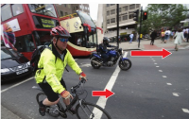
Stretch & Challenge
Stretch and Challenge:
How might we represent different sizes of forces? (Provide example)
Keywords:
Free Body Diagram
Resultant Force
Vector
Contact Force
Non Contact Force
Mass
Weight
Force
Newtons
Reaction Force
Arrows are used to show the direction of forces. The greater the size of the arrow, the greater the force.
In this example the motorcyclist is shown to have a greater thrust (force) moving forward at the traffic light when green as the arrow is larger

Slide 8
Free Body Diagrams Rules
A Free Body Diagram (FBD) has ONLY the object we are interested in drawn on it.
Then you draw the forces acting on that object and the direction they are acting in. e.g. Gravity would be drawn as an arrow downwards and labelled with the force
Remember: Forces come in pairs - No force exists by itself. Every action has an equal and opposite reaction. If you push on something (action) it pushes back (reaction).
Keywords:
Free Body Diagram
Resultant Force
Vector
Contact Force
Non Contact Force
Mass
Weight
Force
Newtons
Reaction Force
Notes:
You could use a bus analogy here and get children involved (Kinesthetic Task)
Pretend you are a bus driver at the front of the class and all the students are passengers.
Give the students a scenario for example you are late on a 697/8 and need to get to school quickly. At the traffic lights you make a quick right turn, get the students to move in the direction they think they will move towards and get them thinking why?
Do the same turning left, accelerating and braking suddenly.
You can get students involved and pretend they are the bus driver at the front
I have tried this a few times and works really well.

Slide 9
Modelled Example
Scenario: A ball of paper is sat on a table, How would we draw a Free Body Diagram?
Tips for drawing FBD:
Draw forces touching the object..
This is a FBD of the ball so we do NOT draw the force on the table caused by the ball.
Notice that the forces are equal in size, and opposite in direction.
For every action force, there is an equal and opposite reaction force
Reaction force upwards - of the table pushing up on the ball.
Keywords:
Free Body Diagram
Resultant Force
Vector
Contact Force
Non Contact Force
Mass
Weight
Force
Newtons
Reaction Force
Weight force downwards - caused by Earth’s gravity pulling down on the ball.

Slide 10
Learning Checkpoint
Task: On your mini whiteboard/exercise books:
Draw a diagram showing the forces on somebody sat on a laboratory stool (Stick diagram) – BE SENSIBLE!
Use arrows to represent the force or force(s)
You do not use to use all arrows
Keywords:
Free Body Diagram
Resultant Force
Vector
Contact Force
Non Contact Force
Mass
Weight
Force
Newtons
Reaction Force
Notes:
(

Slide 11
Think, Pair, Share…
Task: Which free body diagram is correct and explain why?
Normal contact force from chair
Keywords:
Free Body Diagram
Resultant Force
Vector
Contact Force
Non Contact Force
Mass
Weight
Force
Newtons
Reaction Force
A
B
Normal contact force from chair
C
D
Normal contact force from chair
Weight
Weight
Weight

Slide 12
Explanation
Explanation:
The student has remembered that the forces are represented equal in size, and opposite in direction.
The forces have been labelled appropriately
The forces are touching the object
Drawn neatly with a ruler
Keywords:
Free Body Diagram
Resultant Force
Vector
Contact Force
Non Contact Force
Mass
Weight
Force
Newtons
Reaction Force
D
Normal contact force from chair
Weight
Notes:
(

Slide 13
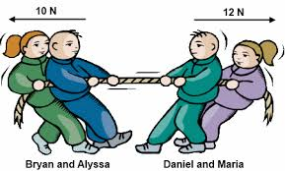
Other Representations
Keywords:
Free Body Diagram
Resultant Force
Vector
Contact Force
Non Contact Force
Mass
Weight
Force
Newtons
Reaction Force
Which team is winning the tug of war?
Explain why using the diagram…
Therefore here, Daniel and Maria are winning the tug of war as there is a greater force of 12N compared to only 10N of Bryan and Alyssa
Sometimes the arrows are the same size. Then we need to look at the amount of force being applied in Newtons (N).
The bigger force will be the one which has the effect on the object.

Slide 14
Learning Checkpoint
Task: You are presented with a variety of scenarios. You are to complete the following based on your level of comfortability
Keywords:
Free Body Diagram
Resultant Force
Vector
Contact Force
Non Contact Force
Mass
Weight
Force
Newtons
Reaction Force
Feeling comfortable?
Name the different forces that are being exerted on these objects and draw arrows to show the direction of the forces
Not feeling very comfortable?
Draw in the arrows to show the directions of the forces

Slide 15
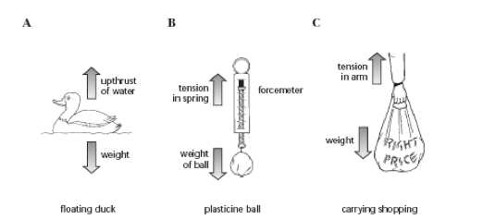
Learning Checkpoint
Keywords:
Free Body Diagram
Resultant Force
Vector
Contact Force
Non Contact Force
Mass
Weight
Force
Newtons
Reaction Force

Slide 16
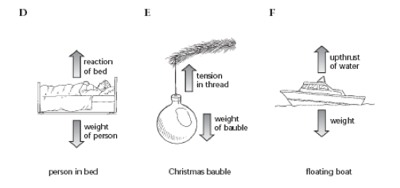
Learning Checkpoint
Keywords:
Free Body Diagram
Resultant Force
Vector
Contact Force
Non Contact Force
Mass
Weight
Force
Newtons
Reaction Force

Slide 17
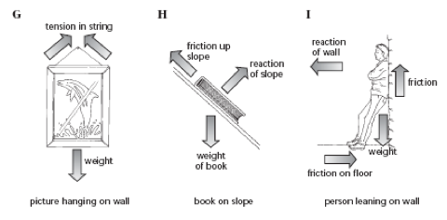
Learning Checkpoint
Keywords:
Free Body Diagram
Resultant Force
Vector
Contact Force
Non Contact Force
Mass
Weight
Force
Newtons
Reaction Force

Slide 18

Free Body Diagrams
Learning objectives:
LO1: State how different forces can be represented and correlate the length of arrows to the size of force (Level 3)
LO2: Describe that forces require both a size and direction, and understand why this is a vector quantity (Level 4)
LO3: Explain and be able to calculate resultant forces (Level 5)

Slide 19
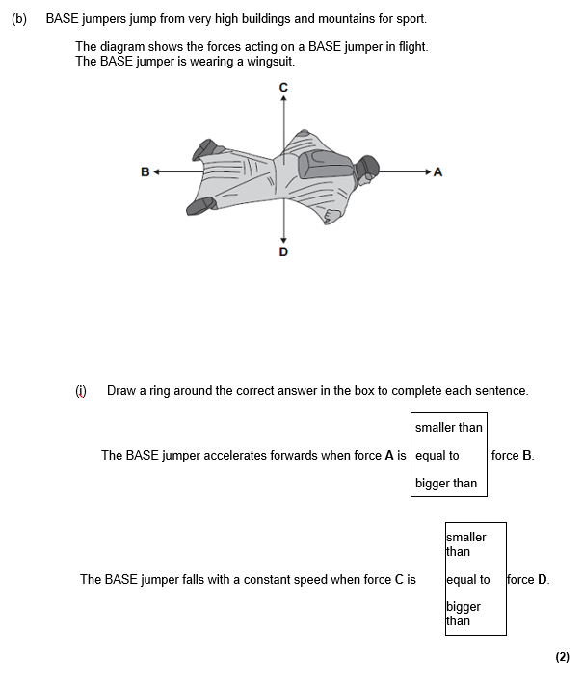
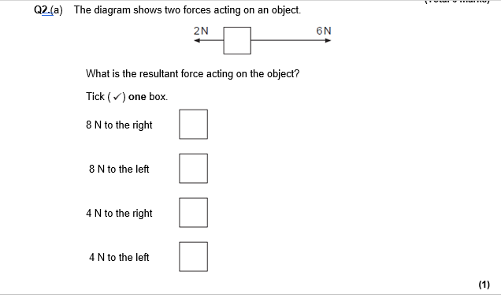
Homework 1: Exam Style Questions
Keywords:
Free Body Diagram
Resultant Force
Vector
Contact Force
Non Contact Force
Mass
Weight
Force
Newtons
Reaction Force
Task:
Complete the Exam Style Questions

Slide 20
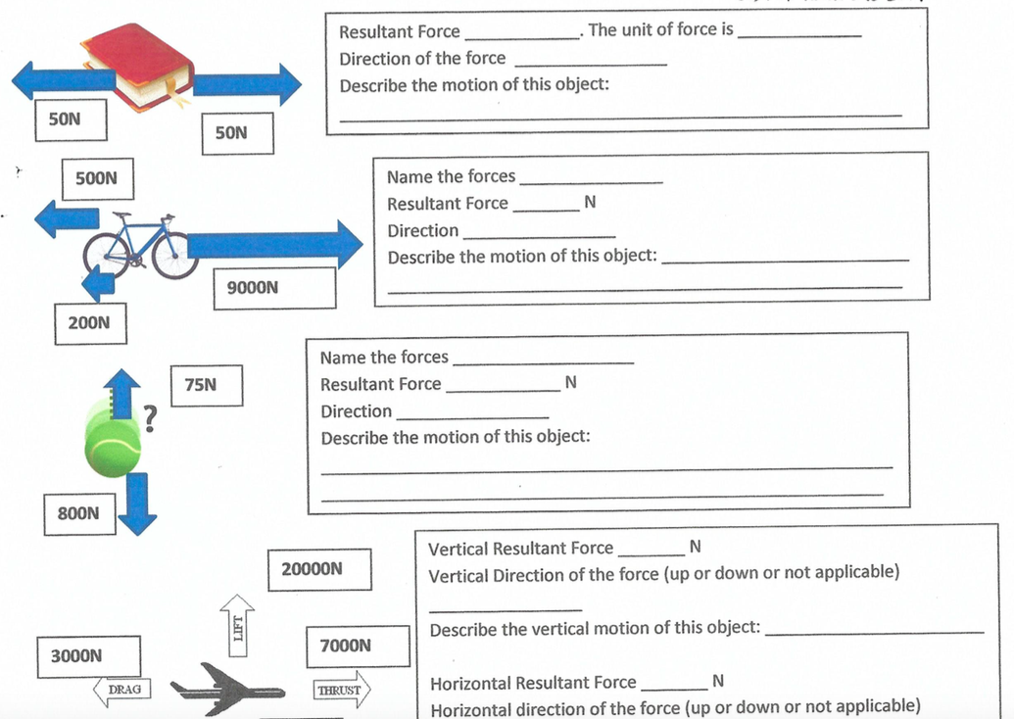
Homework 2: Resultant Forces
Keywords:
Free Body Diagram
Resultant Force
Vector
Contact Force
Non Contact Force
Mass
Weight
Force
Newtons
Reaction Force

Slide 21
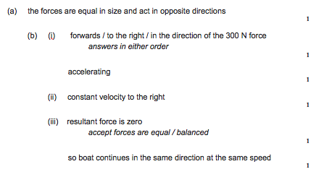
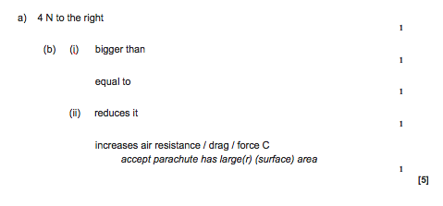
Homework 1

Slide 22
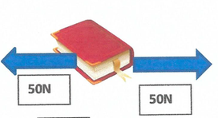
Homework 2
Resultant Force __________
Unit of Force __________
Direction of Force __________
Describe the motion of this object ______________________________
0N
Newtons (N)
N/A
Remains Stationary

Slide 23
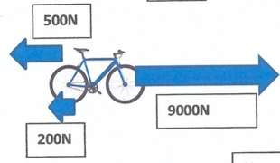
Homework 2
Name the Forces ________________________________
Resultant Force ____________
Direction ______________
Describe the Motion
_____________________________
Thrust (9000N), Drag (500N), Friction (200N)
8300 N
Right
It will accelerate to the right (Resultant Force)

Slide 24
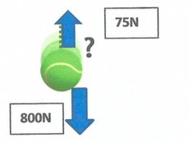
Homework 2
Name the Forces ________________________________
Resultant Force ____________
Direction ______________
Describe the Motion
_____________________________
Weight (800N), Drag (75N)
725 N
Down
It accelerates downwards (Resultant Force)

Slide 25
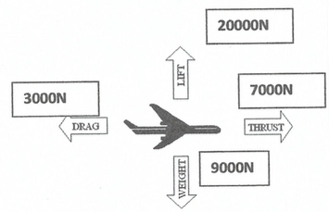
Homework 2
Vertical Resultant Force __________
Vertical Direction (Up, Down or N/A)
___________
Vertical Motion ________________
Horizontal Resultant Force __________
Horizontal Direction ____________
Horizontal Motion _________________
11,000N
Up
Accelerates upwards
4,000N
Right
Accelerates to the right

